Slide 1

Effective Fake News Detection with Machine Learning
PRESENTED BY: UNDER THE GUIDANCE OF:
JIYA GARG (207R1A6688) MR.SK.SHARIF
L.ABHINAV(207R1A6698)
K.SANJAY (207R1A6695)

Slide 2

ABSTRACT
We use a technology that uses methodologies and algorithms for detecting fake news articles, creators and subjects from online social networks.
There are a variety of innovative solutions being developed.
It is crucial that we continue to explore and develop effective solutions to combat the spread of fake news and protect the integrity of information.

Slide 3

EXISTING SYSTEM
The existing system for combating fake news primarily relies on human Effort fact-checkers and journalists.
This process can be time-consuming and labor-intensive in case of large data.
Different organizations use different criteria for determining news is true or false,this can lead to inaccuracies.

Slide 4
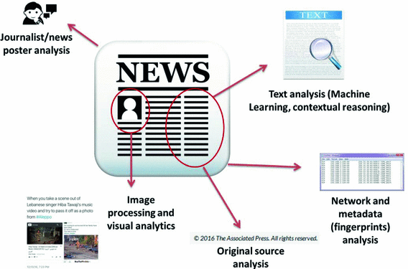
PROPOSED SYSTEM
Our proposed system is a sophisticated AI algorithm that uses Neural Network and machine learning to detect fake news articles.
If the article is considered to be fake, our system will alert the user.
The main Advantage of the system is that it consumes less time and increase accuracy.

Slide 5
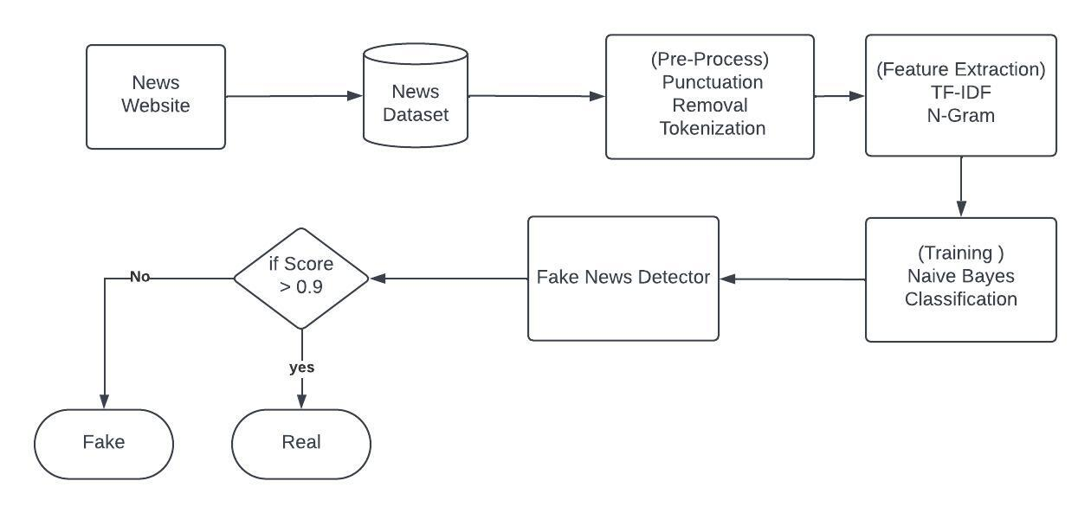
SYSTEM ARCHITECTURE

Slide 6
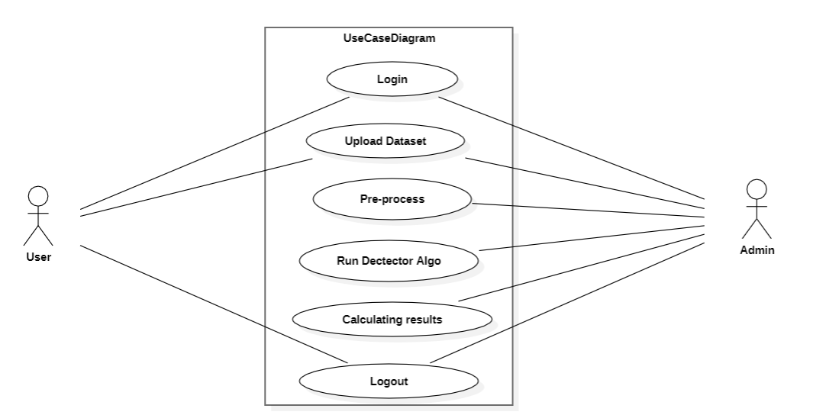

USECASE DIAGRAM
System

Slide 7
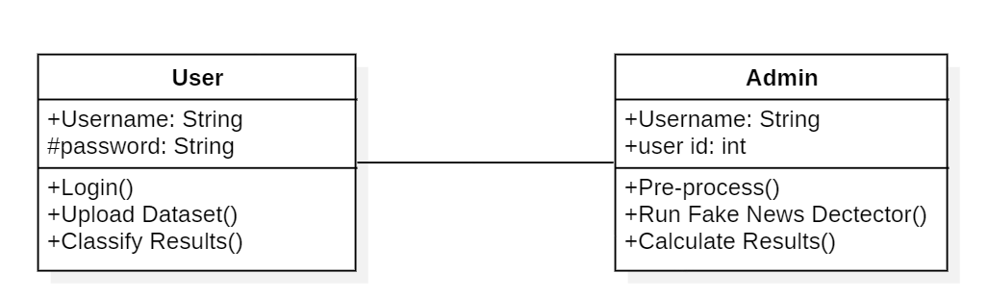
CLASS DIAGRAM
System

Slide 8
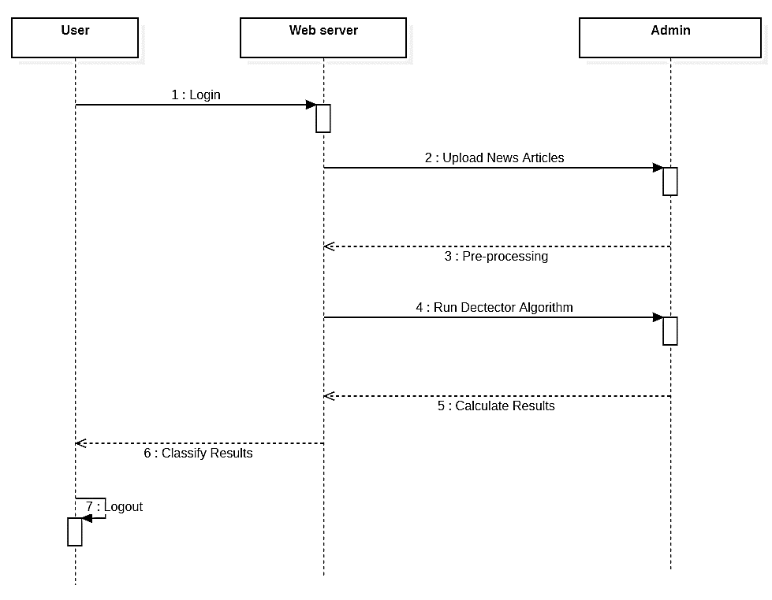
SEQUENCE DIAGRAM
System

Slide 9
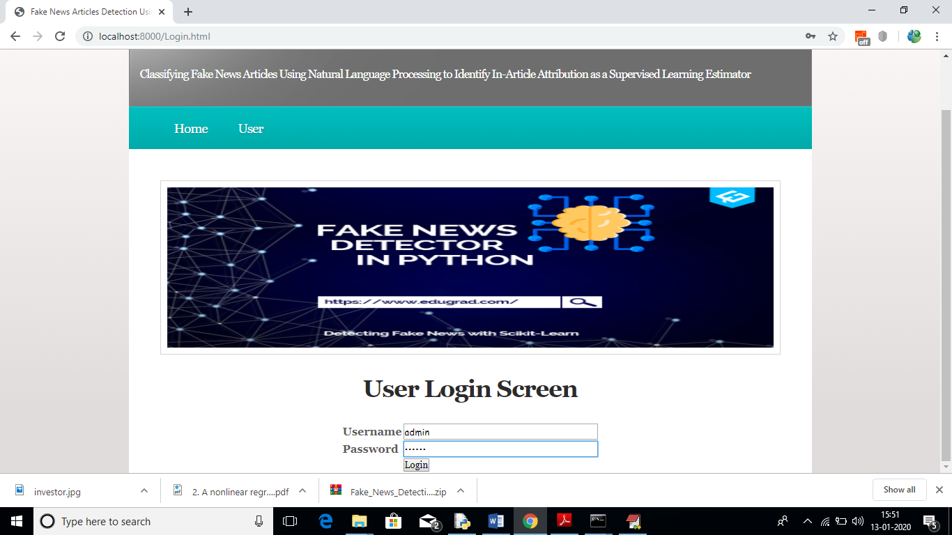
USER INTERFACE DESIGN

Slide 10
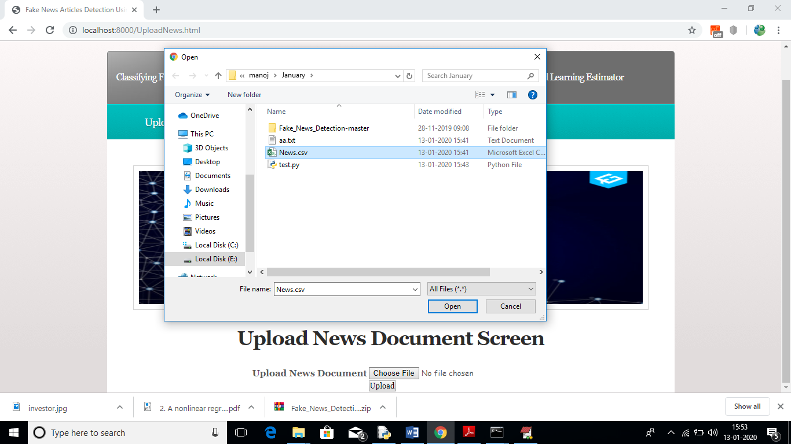
MODEL EXECUTION

Slide 11
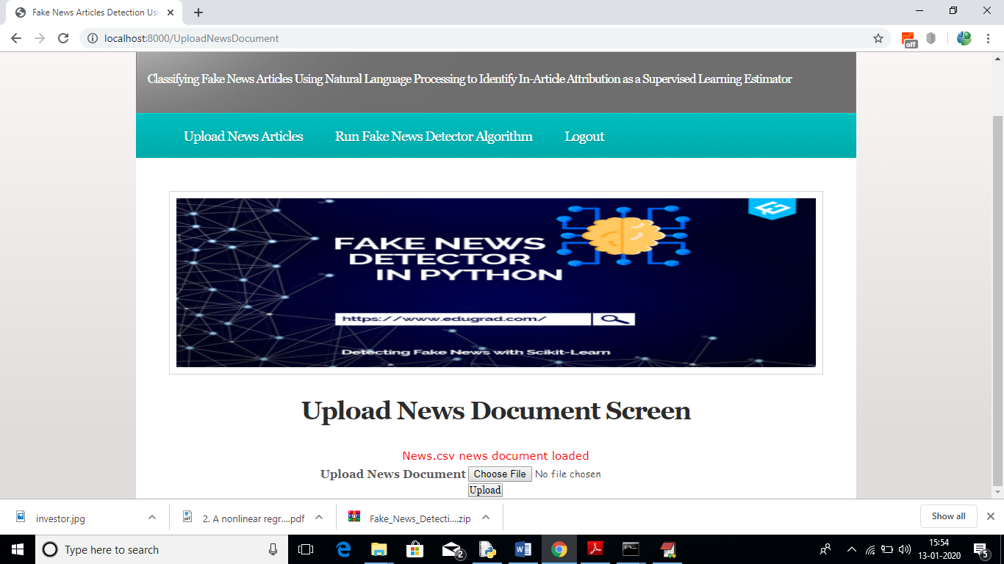
MODEL EXECUTION

Slide 12
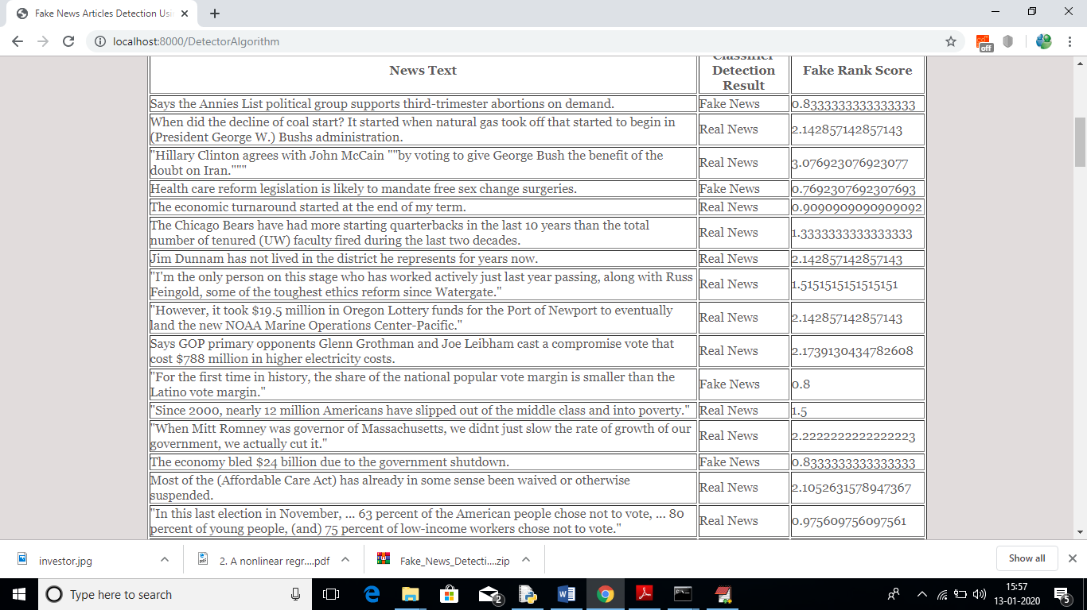
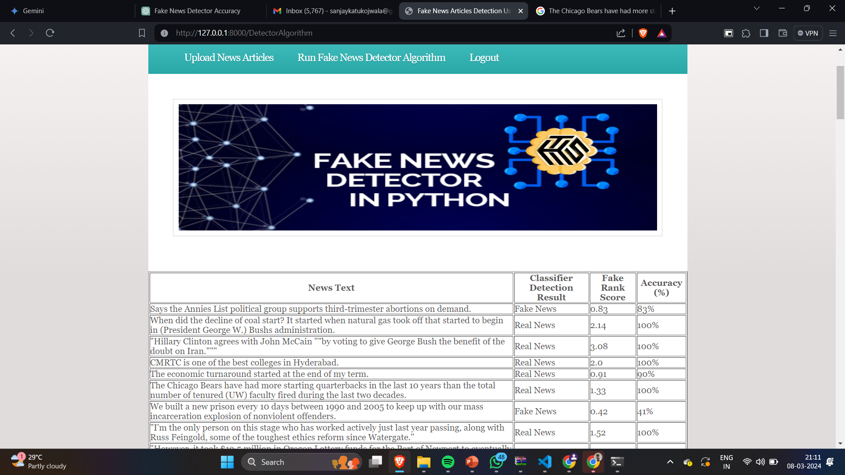
RESULTS

Slide 13

References
Fake news from Kaggle dataset , Real news from Signal Media News.
Tandoc, E. C., Lim, Z. W., & Ling, R. (2017). Defining "Fake News." Digital Journel 6(2), 137–153. doi:10.1080/21670811.2017.1360143.
Marchi, R. (2012). With Facebook, blogs, and fake NEWS, Teens Reject Journalistic "Objectivity' Journal of Communication Inquiry, 36(3), 246-262. doi:10.1177/0196859912458700.
Price, V., & Zaller, J. (1993). Who gets the news? Alternative measures of news reception and their implications for research. Public Opinion Quarterly, 57(2), 133. doi:10.1086/269363.
Balmas, M. (2012). When fake news becomes real. Communication Research, 41(3), 430-454.

Slide 14
THANK YOU FOR YOUR ATTENTION…. ANY QUERIES?

